Slide 1
Cardiovascular Genomics
An introduction to the analysis of SNPs in cardiovascular disease

Slide 2
Introduction
Basic genetics
Genetics & Family history
Types of studies
WTCCC
So what about genetics in atherosclerosis and consequent cardiovascular disease?

Slide 3
The human genome
Introduction to Some Genomics

Slide 4
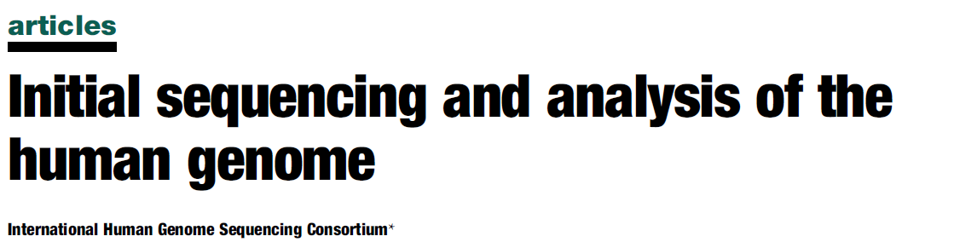
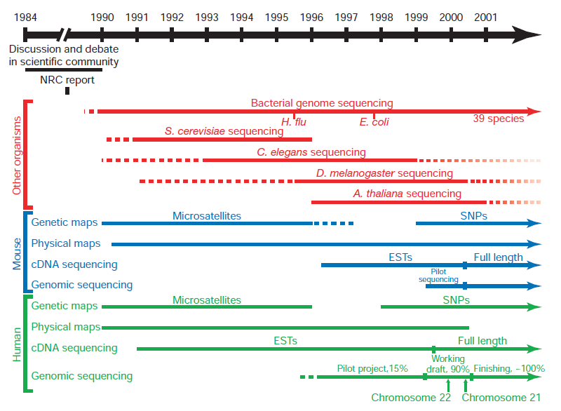
Human Genome Project: 2001
Largest publication ever in Nature, February 2001: 62 pages
“Back-to-back with a publication by Craig Venter, et al. in Science

Slide 5
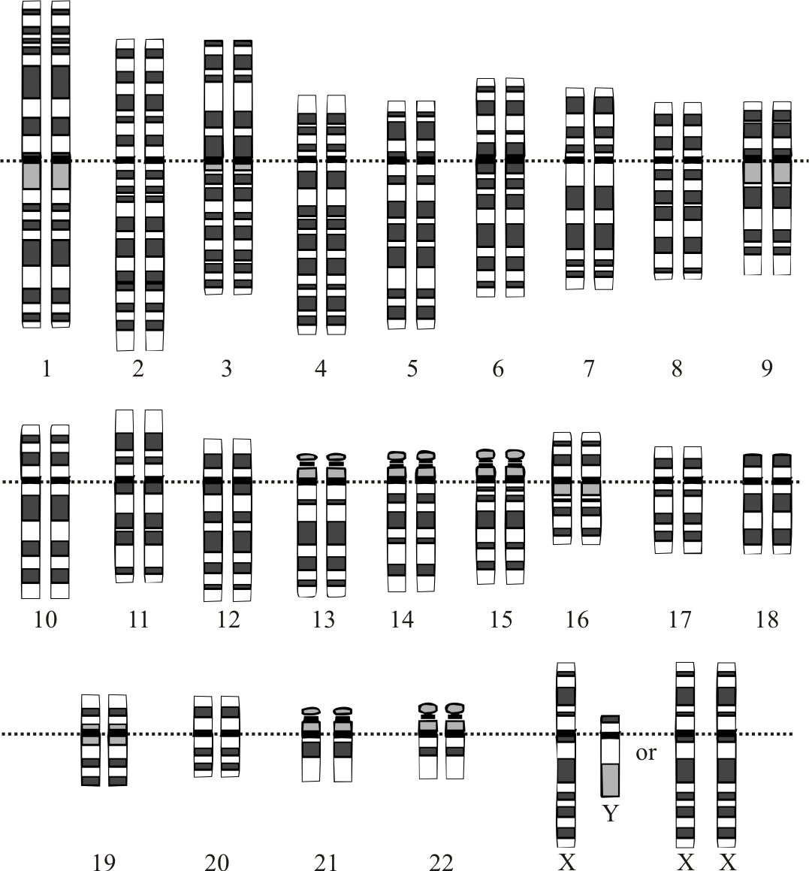
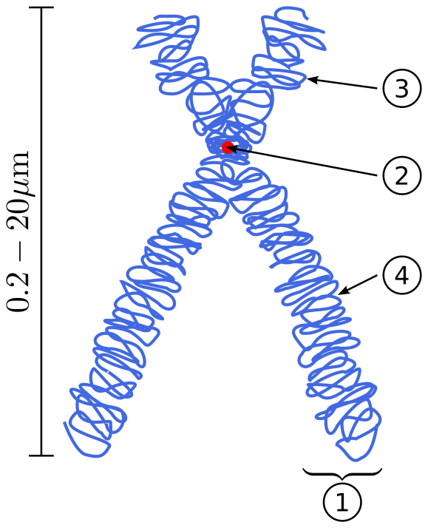
Human Genome: the chromosomes
Chromosomes:
Autosomes, 22 pairs
Sex-chromosomes, X and Y
One copy of one (part) of the chromosome(s) of each of your parents
1) chromatid
2) centromere
3) short arm, p
4 short arm, q

Slide 6
Human Genome: some statistics
3.2 billion base pairs in the haploid genome
≈ 20,000-25,000 genes
≈23,000 coding for proteins
Only 1.5% of the total genome
Rest of the genome:
Non-coding RNA (rRNA, tRNA)
Regulatory sequences
Repetitive elements
Variable number of tandem repeats (VNTR)
Copy-number variations (CNV)
Transposable elements
Viral or bacterial origins

Slide 7
ATGCCGATCGTACGACACATATCGTCATCGTACTGACTGTCTAGTCTAAACACATCCATCGTACTGACTGCATCGATCCATTTTA
TACTGACTGCATCGTACTGACTGCACATATCGTCATCGTACTGACTGTCTAGTCTAAACACATCCCACATATCGTTTACCCCATG
CATCGTACTGACTGTCTAGTCTAAACACATCCCACATATCGTCATCGTACTGACTGTCTAGTCTAAACACATCCCAGCATCCATC
CATATCGTCATCGTACTGACTGTCTAGTCTAAACACATCCTATGCCGATCGTACGACACATATCGTCATCGTACTGCCCTACGGG
ACTGTCTAGTCTAAACACATCCATCGTACTGACTGCATCGTACTGACTGCATCGTACTGACTGCACATATCGTCATACATAGACT
TCGTACTGACTGTCTAGTCTAAACACATCCCACATATCGTCATCGTACTGACTGTCTAGTCTAAACACATCCCACTTTACCCATG
ATATCGTCATCGTACTGACTGTCTAGTCTAAACACATCCCACATATCGTCATCGTACTGACTGTCTAGTCTAAACACATCCTATA
GCCGATCGTACGACACATATCGTCATCGTACTGCCCTACGGGACTGTCTAGTCTAAACACATCCATCGTACTGACTGCATCGTAC
TGACTGCATCGTACTGACTGCACATATCGTCATACATAGACTTCGTACTGACTGTCTAGTCTAAACACATCCCACATATCGTCAT
CGTACTGACTGTCTAGTCTAAACACATCCCACTTTACCCATGCATCGTACTGACTGTCTAGTCTAAACACATCCCACATATCGTC
ATCGTACTGACTGTCTAGTCTAAACACATCCCAGCATCCATCCATATCGTCATCGTACTGACTGTCTAGTCTAAACACATCCTAT
GCCGATCGTACGACACATATCGTCATCGTACTGCCCTACGGGACTGTCTAGTCTAAACACATCCATCGTACTGACTGCATCGTAC TGACTGCATCGTACTGACTGCACATATCGTCATACATAGACTTCGTACTGACTGTCTAGTCTAAACACATCCCACATATCGTCAT
CGTACTGACTGTCTAGTCTAAACACATCCCACTTTACCCATGATATCGTCATCGTACTGACTGTCTAGTCTAAACACATCCCACA
TATCGTCATCGTACTGACTGTCTAGTCTAAACACATCCTATACATATCGTCATCGTACTGACTGTCTAGTCTAAACACATCCTAT
GCCGATCGTACGACACATATCGTCATCGTACTGCCCTACGGGACTGTCTAGTCTAAACACATCCATCGTACTGACTGCATCGTAC
TGACTGCATCGTACTGACTGCACATATCGTCATACATAGACTTCGTACTGACTGTCTAGTCTAAACACATCCCACATATCGTCAT
CGTACTGACTGTCTAGTCTAAACACATCCCACTTTACCCATGATATCGTCATCGTACTGACTGTCTAGTCTAAACACATCCCACA
TATCGTCATCGTACTGACTGTCTAGTCTAAACACATCCTATAGCCGATCGTACGACACATATCGTCATCGTACTGCCCTACGGGA
CTGTCTAGTCTAAACACATCCATCGTACTGACTGCATCGTACGCCGATCGTACGACACATATCGTCATCGTACTGCCCTACGGGA
CTGTCTAGTCTAAACACATCCATCGTACTGACTGCATCGTACTGACTGCATCGTACTGACTGCACATATCGTCATACATAGACTT
CGTACTGACTGTCTAGTCTAAACACATCCCACATATCGTCATCGTACTGACTGTCTAGTCTAAACACATCCCACTTTACCCATGC
ATCGTACTGACTGTCTAGTCTAAACACATCCCACATATCGTCATCGTACTGACTGTCTAGTCTAAACACATCCCAGCATCCATCC
ATATCGTCATCGTACTGACTGTCTAGTCTAAACACATCCTATGCCGATCGTACGACACATATCGTCATCGTACTGCCCTACGGGA
CTGTCTAGTCTAAACACATCCATCGTACTGACTGCATCGTACGACTGCATCGTACTGACTGCACATATCGTCATACATAGACTTC
GTACTGACTGTCTAGTCTAAACACATCCCACATATCGTCATCGTACTGACTGTCTAGTCTAAACACATCCCACTTTACCCATGAT
ATCGTCATCGTACTGACTGTCTAGTCTAAACACATCCCACACTGTCTAGTCTAAACACATCCATCGTACTGACTGCATCGTACGC
CGATCGTACGACACATATCGTCATCGTACTGCCCTACGGGACTGTCTAGTCTAAACACATCCATCGTACTGACTGCATCGTACTG

Slide 8
Most of genetic variation is due to single nucleotide polymorphisms (SNPs) --single base changes that are common in the general population
ATGCCGATCGTACGACACATATCGTCATCGTACTGACTGTCTAGTCTAAACACATCCATCGTACTGACTGCATCGATCCATTTTA
TACTGACTGCATCGTACTGACTGCACATATCGTCATCGTACTGACTGTCTAGTCTAAACACATCCCACATATCGTTTACCCCATG
CATCGTACTGACTGTCTAGTCTAAACACATCCCACATATCGTCATCGTACTGACTGTCTAGTCTAAACACATCCCAGCATCCATC
CATATCGTCATCGTACTGACTGTCTAGTCTAAACACATCCTATGCCGATCGTACGACACATATCGTCATCGTACTGCCCTACGGG
ACTGTCTAGTCTAAACACATCCATCGTACTGACTGCATCGTACTGACTGCATCGTACTGACTGCACATATCGTCATACATAGACT
TCGTACTGACTGTCTAGTCTAAACACATCCCACATATCGTCATCGTACTGACTGTCTAGTCTAAACACATCCCACTTTACCCATG
ATATCGTCATCGTACTGACTGTCTAGTCTAAACACATCCCACATATCGTCATCGTACTGACTGTCTAGTCTAAACACATCCTATA
GCCGATCGTACGACACATATCGTCATCGTACTGCCCTACGGGACTGTCTAGTCTAAACACATCCATCGTACTGACTGCATCGTAC
TGACTGCATCGTACTGACTGCACATATCGTCATACATAGACTTCGTACTGACTGTCTAGTCTAAACACATCCCACATATCGTCAT
CGTACTGACTGTCTAGACTAAACACATCCCACTTTACCCATGCATCGTACTGACTGTCTAGTCTAAACACATCCCACATATCGTC
ATCGTACTGACTGTCTAGTCTAAACACATCCCAGCATCCATCCATATCGTCATCGTACTGACTGTCTAGTCTAAACACATCCTAT
GCCGATCGTACGACACATATCGTCATCGTACTGCCCTACGGGACTGTCTAGTCTAAACACATCCATCGTACTGACTGCATCGTAC TGACTGCATCGTACTGACTGCACATATCGTCATACATAGACTTCGTACTGACTGTCTAGTCTAAACACATCCCACATATCGTCAT
CGTACTGACTGTCTAGTCTAAACACATCCCACTTTACCCATGATATCGTCATCGTACTGACTGTCTAGTCTAAACACATCCCACA
TATCGTCATCGTACTGACTGTCTAGTCTAAACACATCCTATACATATCGTCATCGTACTGACTGTCTAGTCTAAACACATCCTAT
GCCGATCGTACGACACATATCGTCATCGTACTGCCCTACGGGACTGTCTAGTCTAAACACATCCATCGTACTGACTGCATCGTAC
TGACTGCATCGTACTGACTGCACATATCGTCATACATAGACTTCGTACTGACTGTCTAGTCTAAACACATCCCACATATCGTCAT
CGTACTGACTGTCTAGTCTAAACACATCCCACTTTACCCATGATATCGTCATCGTACTGACTGTCTAGTCTAAACACATCCCACA
TATCGTCATCGTACTGACTGTCTAGTCTAAACACATCCTATAGCCGATCGTACGACACATATCGTCATCGTACTGCCCTACGGGA
CTGTCTAGTCTAAACACATCCATCGTACTGACTGCATCGTACGCCGATCGTACGACACATATCGTCATCGTACTGCCCTACGGGA
CTGTCTAGTCTAAACACATCCATCGTACTGACTGCATCGTACTGACTGCATCGTACTGACTGCACATATCGTCATACATAGACTT
CGTACTGACTGTCTAGTCTAAACACATCCCACATATCGTCATCGTACTGACTGTCTAGTCTAAACACATCCCACTTTACCCATGC
ATCGTACTGACTGTCTAGTCTAAACACATCCCACATATCGTCATCGTACTGACTGTCTATTCTAAACACATCCCAGCATCCATCC
ATATCGTCATCGTACTGACTGTCTAGTCTAAACACATCCTATGCCGATCGTACGACACATATCGTCATCGTACTGCCCTACGGGA
CTGTCTAGTCTAAACACATCCATCGTACTGACTGCATCGTACGACTGCATCGTACTGACTGCACATATCGTCATACATAGACTTC
GTACTGACTGTCTAGTCTAAACACATCCCACATATCGTCATCGTACTGACTGTCTAGTCTAAACACATCCCACTTTACCCATGAT
ATCGTCATCGTACTGACTGTCTAGTCTAAACACATCCCACACTGTCTAGTCTAAACACATCCATCGTACTGACTGCATCGTACGC
CGATCGTACGACACATATCGTCATCGTACTGCCCTACGGGACTGTCTAGTCTAAACACATCCATCGTACTGACTGCATCGTACTG

Slide 9
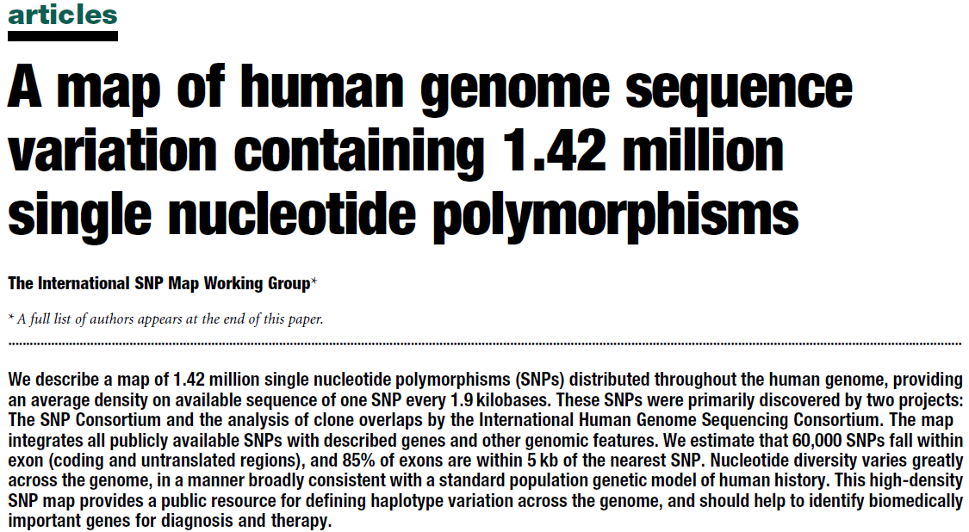
Human genome: individual variations
Human genome is 99.9% similar between individuals
0.1% different → individual point variations
Single-nucleotide polymorphisms

Slide 10
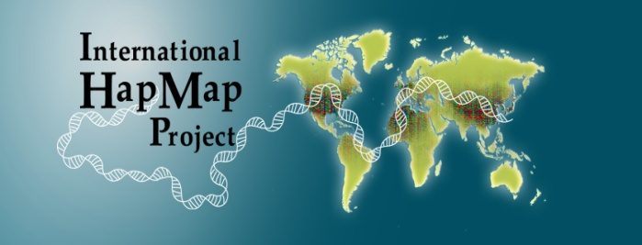
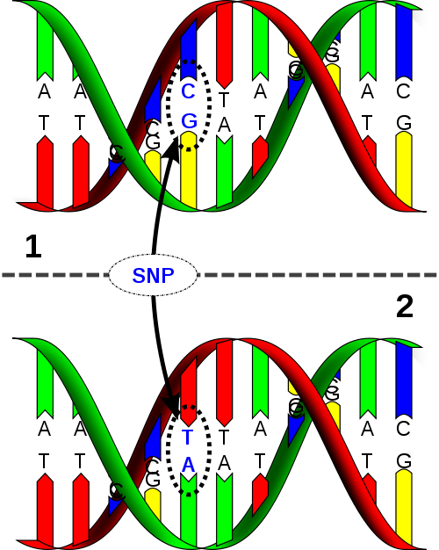
Single-Nucleotide Polymorphism a genetic variation as proxy
Single-nucleotide polymorphism (SNP)
“one base pair variation”
> 1% general population
≈10 million SNPs (≈0.25% genome)
Makes you and me unique
SNPs are common variants which are used as proxies of the actual genomic variation
www.hapmap.org
Maternal copy
Paternal copy

Slide 11
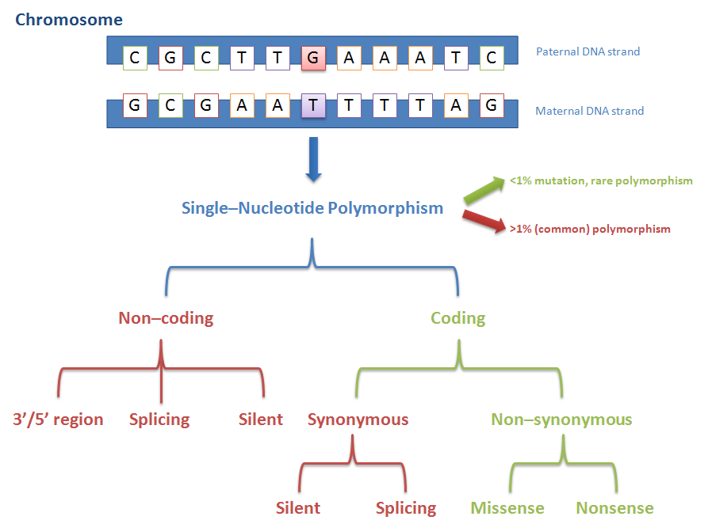
Types of SNPs

Slide 12
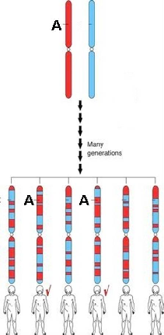
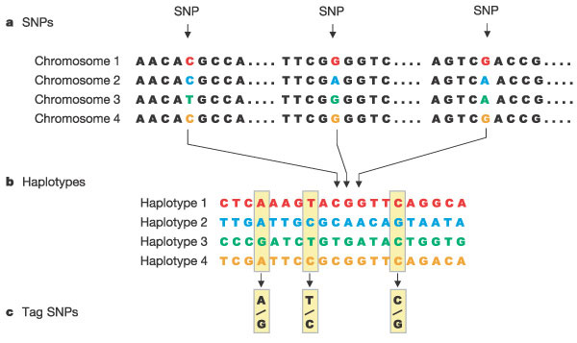
SNPs → Haplotype → tagSNP

Slide 13
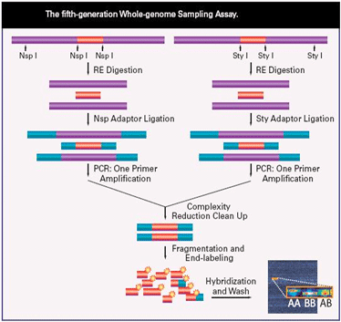
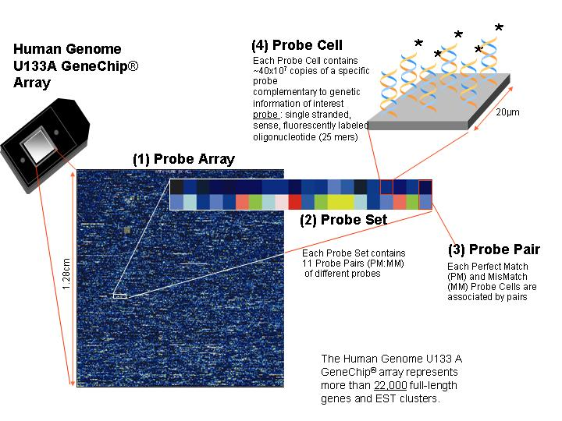
SNP “genotyping”

Slide 14
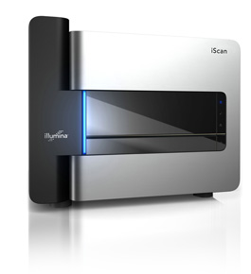


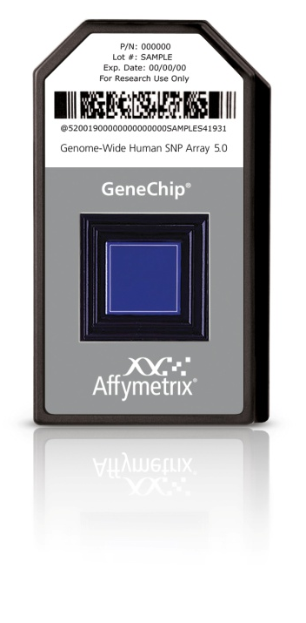
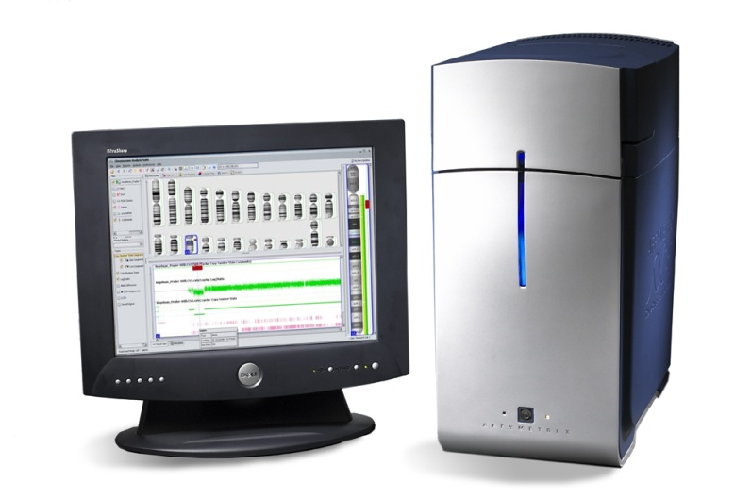

Genotyping Platforms

Slide 15
Genotyping Platforms: examples
Affymetrix Genome-Wide Human SNP Array 5.0
500,568 SNPs
Chromosomal coverage
Good representation of autosomal chromosomes
X-chromosome poor representation
No Y-chromosome representation
No mitochondrial chromosome representation
Illumina Human660W-Quad v1
657,366 SNPs
Chromosomal coverage
Good representation of autosomal chromosomes
X-chromosome reasonable representation
Y-chromosome poor representation
Mitochondrial chromosome poor representation

Slide 16
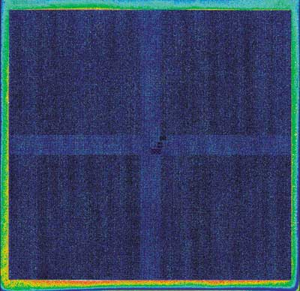
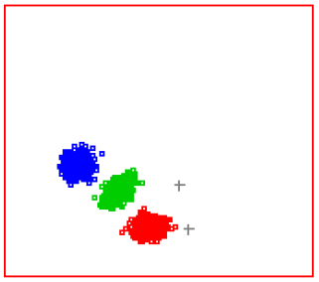

Genotyping Platforms: genotype calling
Several mathematical algorithms exist
Several software programs use different algorithms
All are platform independent (Illumina, Affmetrix)
BEAGLECALL
Birdsuite
BRLMM-P
One picture per chip/patient
Clustering for each SNP!!!

Slide 17
Cardiovascular genomics

Slide 18
Family history
Framingham Heart Study | www.framinghamheartstudy.org
A positive history of cardiovascular disease and associated risk factors tend to aggregate in families
Familial aggregation heritability of CVD estimated ≥90% (before 46 years)
Family history is an independent risk factor (FHS)
Positive family history associated with pre-clinical atherosclerosis as measured by carotid IMT, h² ≈ 0.35
High concordance rate among monozygotic twins, compared to dizygotic twins
Heritability of atherosclerosis (carotid IMT) h² ≈ 0.21-0.64 and is increased by age and cardiovascular risk factors
There is clearly a heritability factor for atherosclerotic and consequent cardiovascular disease

Slide 19
What type of disease are we looking at? monogenic diseases
Monogenic diseases
Mendelian pattern
Autosomal dominant, e.g.:
Marfan Syndrome
Familiar hypercholesterolemia
Autosomal recessive , e.g.:
Sickle cell anemia
Cystic fibrosis
X-linked , e.g.:
Duchene muscular dystrophy
Y-linked/Mitochondrial

Slide 20
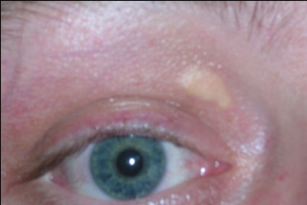
Monogenic disease Familial Hypercholesterolemia (FH)
Characterized by high cholesterol levels (LDL)
Genetic variations in cholesterol metabolism genes
One copy of mutant LDLR (heterozygote) CVD before 30-40 years
Two copies of mutant LDLR (homozygote) severe cardiovascular problems in childhood
Heterozygous FH: 1:500
Homozygous FH: 1:1,000,000
Genes involved:
LDLR, LDL-receptor (prevalence 1 in 500)
Class I: LDLR is not synthesized
Class II: No proper transportation of LDLR endoplasmic reticulum to the Golgi apparatus
Class III: LDLR does not properly bind LDL on the cell surface (apoB/LDLR)
Class IV: LDLR bound to LDL does not properly cluster in clathrin-coated pits for receptor-mediated endocytosis
Class V: No recycling to the cell surface of LDLR
ApoB, apoprotein B100 (prevalence 1 in 1,000)
Mutation of one amino acid (arginine to glutamine) no proper binding of LDLR
Other genes: PCSK9, LDLRAP1 (prevalence less than 1 in 2,500)
Xanthelasma palpebrarum

Slide 21
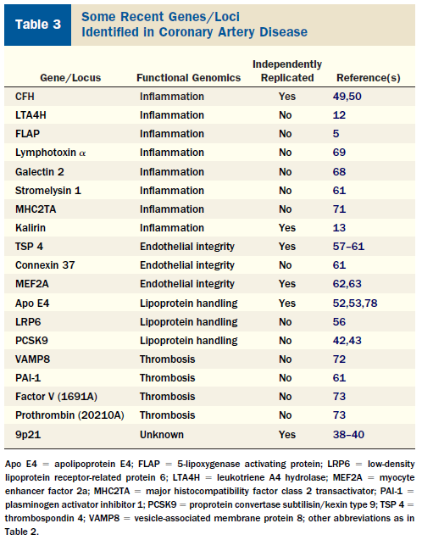
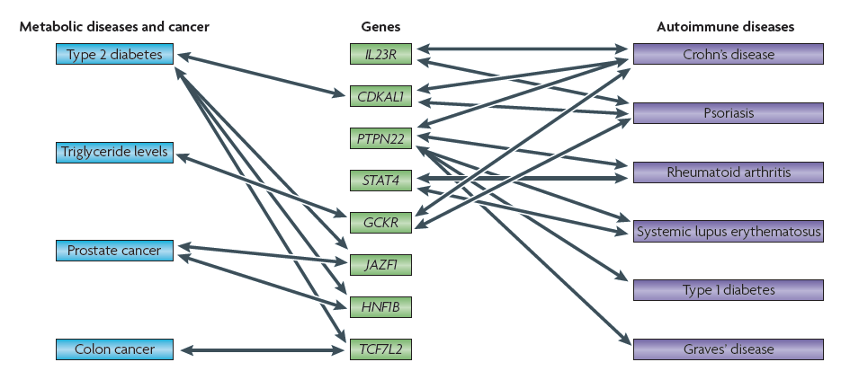
What type of disease are we looking at? complex diseases
Complex diseases
Polygenic, multifactorial diseases
Diabetis mellitus
Asthma
Cardiovascular disease
Hypertension
Each gene contributes a little to the disease
Damani, S.B. et al. JACC; 50(20):1933-1940; 2007

Slide 22
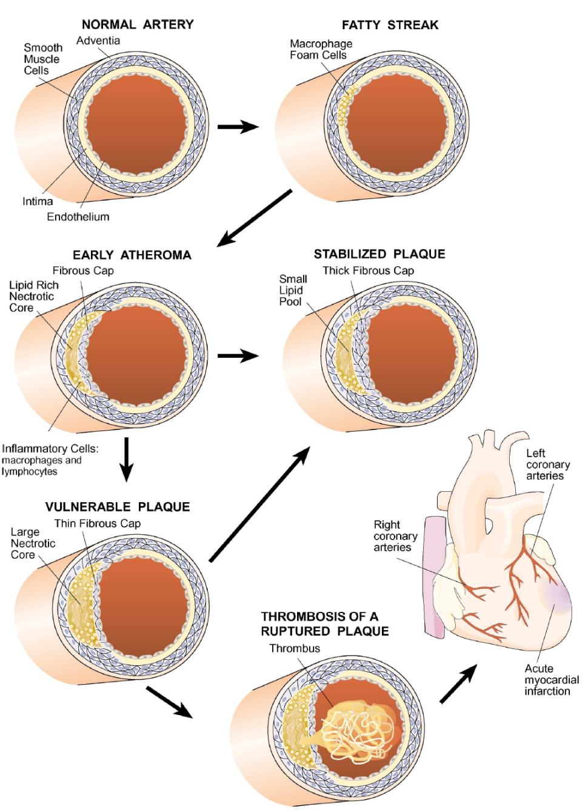
Atherosclerosis & Cardiovascular Disease a very complex process and disease
Lusis, A.J., et al. Annu Rev Genomics Human Genet; 5:189-218; 2004

Slide 23
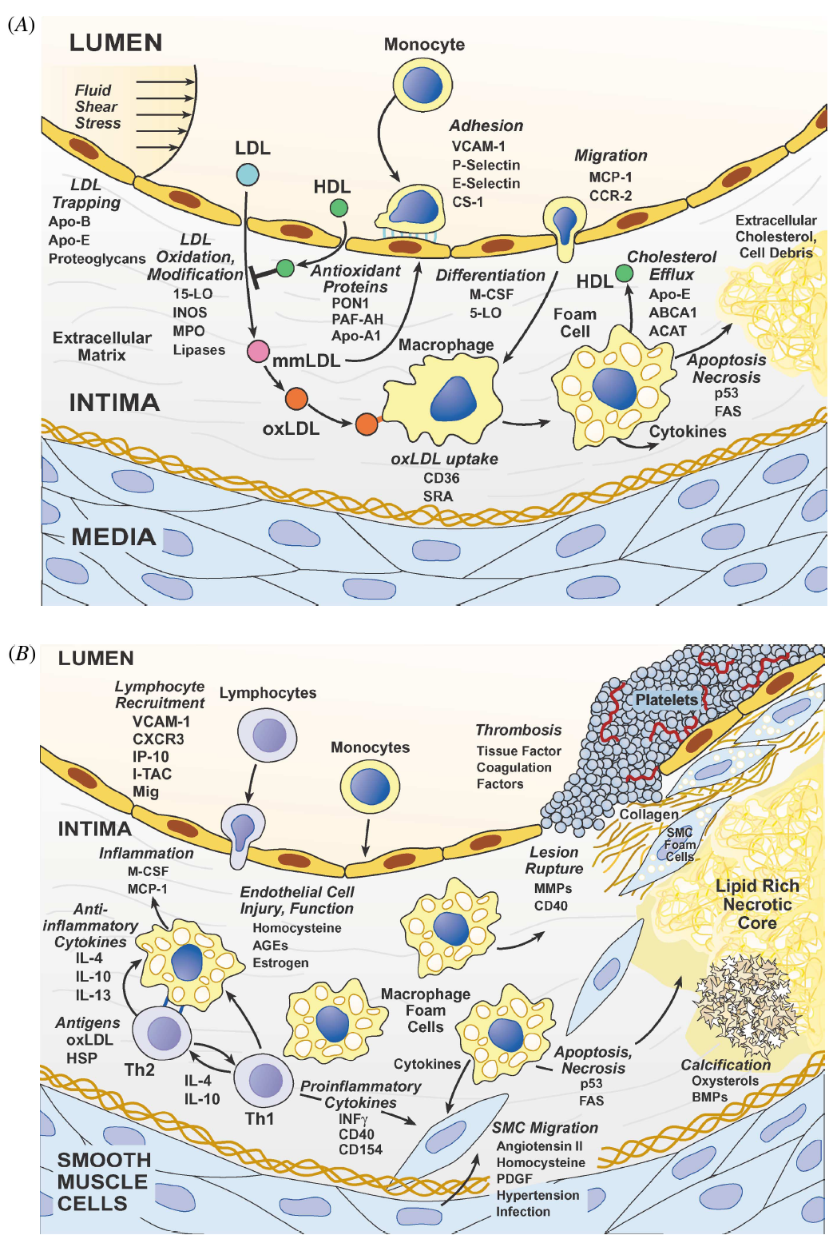
Atherosclerosis & Cardiovascular Disease a very complex process and disease

Slide 24
Atherosclerosis & Cardiovascular Disease a very complex process and disease

Slide 25
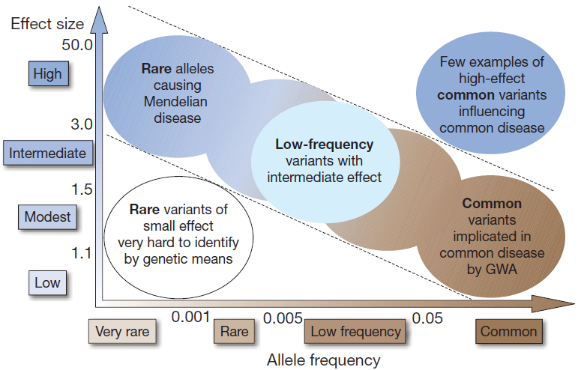
Common Disease, Common Variant CDCV, Effect size, and Allele frequency
“Common Disease, Common Variant” (CDCV) hypothesis:
Common variants (SNPs) underlie common diseases/traits (atherosclerotic disease)
Why? Evolution: natural selection, fitness & genetic drift
Effect size vs. Allele frequency
Low to intermediate penetrance
Low to intermediate odds ratio (OR) 1.1-1.5
Higher penetrance results in decreased reproductive fitness (unlikely in common diseases!)
Manolio, T.A., et al. Nature; 461:747-753; 2009

Slide 26
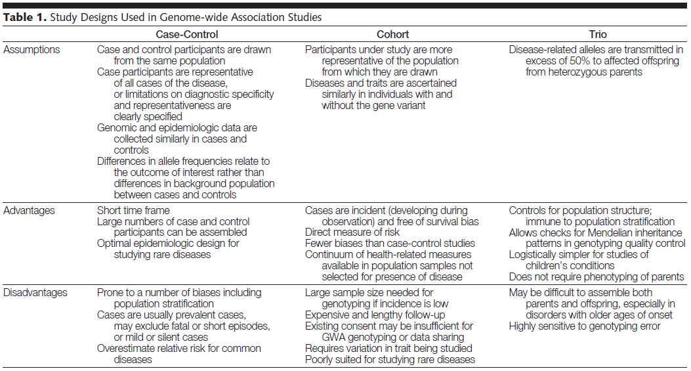
What type of study design can you choose? genome-wide association study
GWAS is hypothesis-free: no a priori ideas on which variant is associated

Slide 27
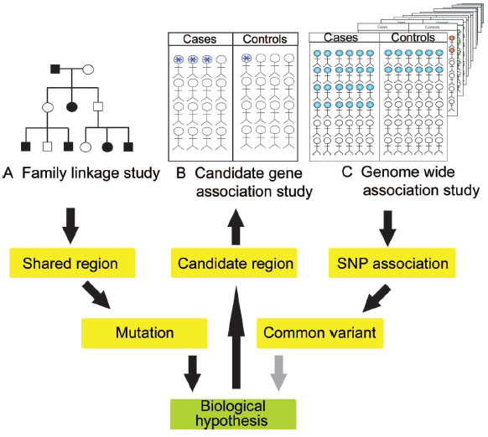
To hypothesize or not to hypothesize…
Family linkage study
Trio-design: parents plus child
Candidate Gene Association Study
A priori hypothesis
Genome-Wide Association Study
No a priori hypothesis
Cases: some phenotype of interest
Controls: random population sample

Slide 28
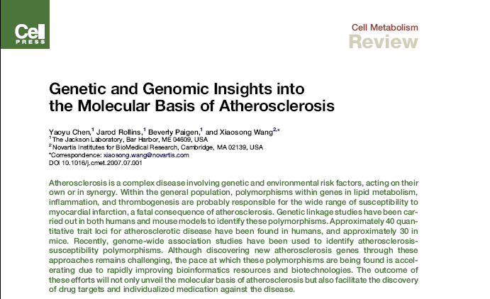
Chen et al. genetics and genomics of atherosclerosis
19 studies in 9 populations identified 40 disease-regulating loci
4x study Coronary Artery Disease (CAD): 9
6x study Myocardial Infarction (MI): 12
1x study CAD & MI: 1
1x study Acute Coronary Syndrome (ACS): 3
2x study Carotid Intimal-Medial Thickness (CIMT): 9
2x study Coronary Artery Calcification (CAC): 4
2x study Cerebral Vascular Accident (CVA=stroke): 1
1x study Peripheral Artery Disease (PAD): 1

Slide 29

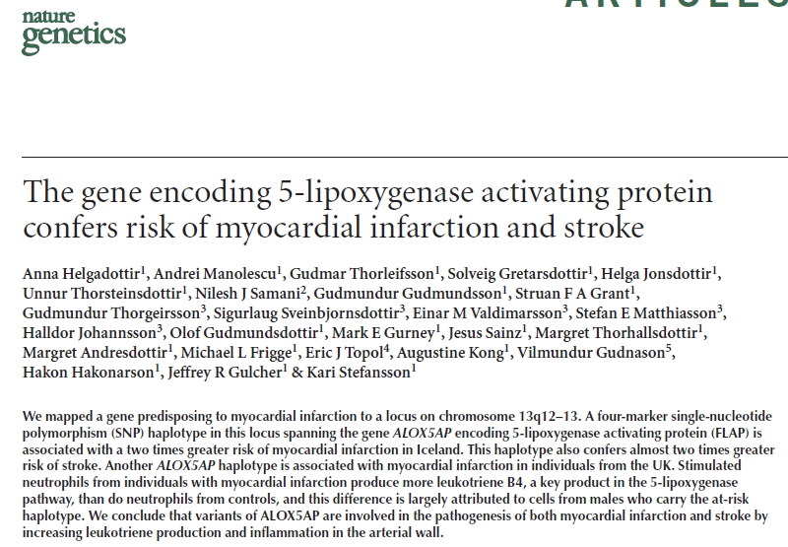
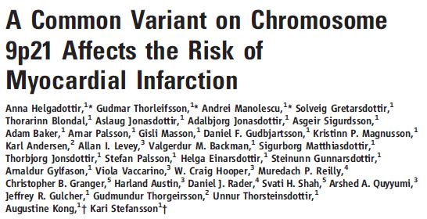
deCODE Genetics, Inc.
>50% adult population of Iceland (>140,000) in biobank (blood)
Pedigree information going back to the first settlements (≈1000 years ago)
Extensive medical records & genotypic data
Over 250 high-impact publications (Nature, Science, AJHG)
50 common diseases
Stroke (=CVA) association with ALOX5AP
MI association with ALOX5AP
Association of a variant on 9p21.1 with Abdominal aortic aneurysm (AAA), intracrainial aneurysm, stroke and MI
Helgadottir, A., et al. Nature Genetics; volume 36, 233; 2004
Helgadottir, A., et al. Science volume 316, 1491; 2007

Slide 30
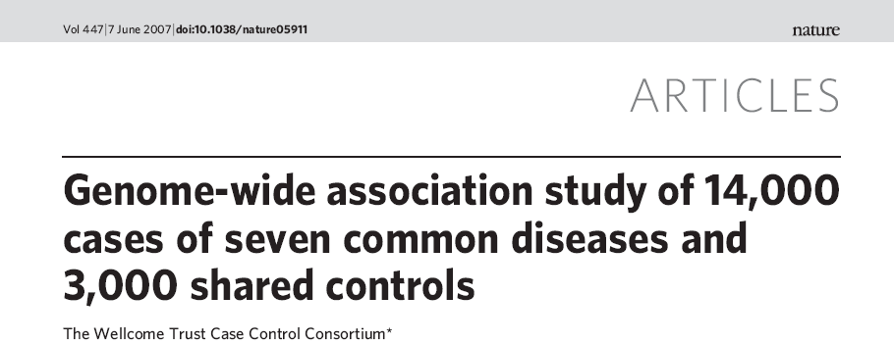
Wellcome Trust Case-Control Consortium
1,500 1958 Birth Cohort Controls (58BC)
1,500 UK Blood Services Controls (UKBS)
14,000 cases of seven common diseases
Bipolar disorder
Coronary artery disease
Crohn's disease
Hypertension
Rheumatoid arthritis
Type 1 diabetes
Type 2 diabetes

Slide 31
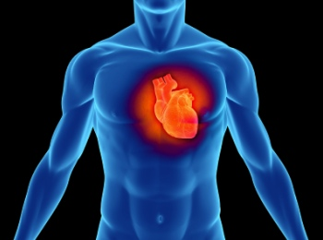
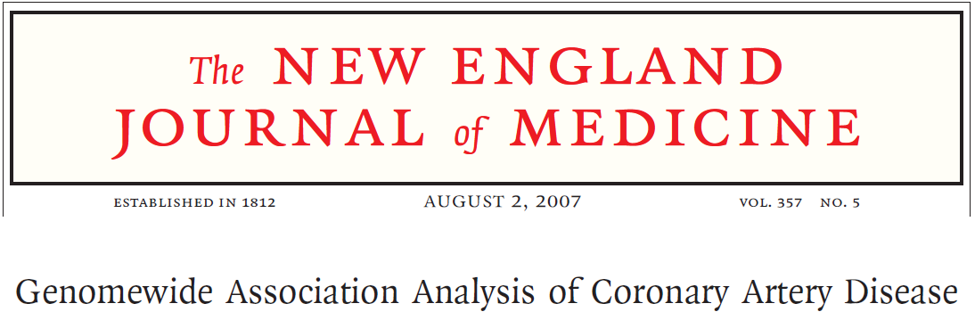
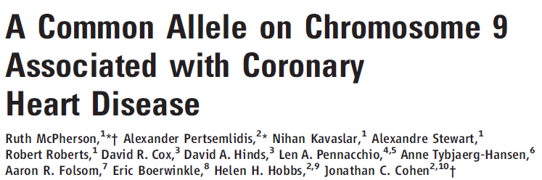
One famous example 9p21
deCODE Genetics was the first to discover a SNP associated with myocardial infarction (MI) in 2007
WTCCC, McPherson, and Samani were able to replicate the same finding in the same year, and many have reconfirmed it in different populations
Helgadottir, A., et al. Science; 316(5830):1491-1493, 2007
McPherson, R., et al. Science; 316(5830):1488-1491, 2007
Wellcome Trust Case Control Consortium. Nature; 447(7145):661-678, 2007
Samani, N.J., et al. N Engl J Med; 357(5):443-453, 2007

Slide 32
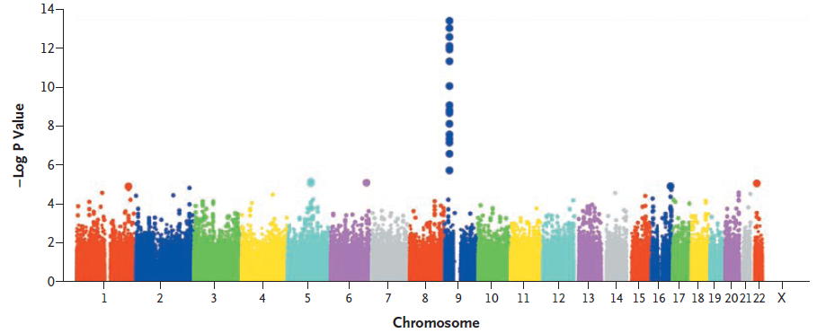
One famous example 9p21 in the WTCCC
-Log10 of the associated p-value
A Manhattan skyscraper of significance at a region (9p21) associated with the trait (CAD), rs1333049
Genome-wide significance level 5.0x10⁻⁰⁸, which is correcting for 2x500,000 tests (Bonferroni)
Each dot represents one SNP
Suggestive genome-wide significance level 5.0x10⁻⁰⁴
Each SNP is plotted per chromosome in genomic positional order
Samani, N.J. et al. N Engl J Med; 357:443-53; 2007

Slide 33
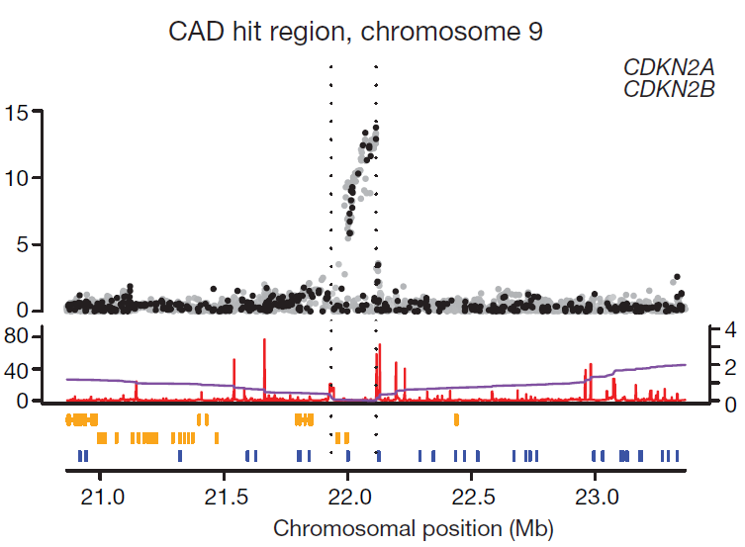
One famous example 9p21 a closer look
The SNPs on 9p21.1 are rs1333049, rs10757274, rs2383207, rs2891168, and rs10757278
They are found in an intergenic region
Genes nearby: CDKN2A, CDKN2B
also associated with type 2 diabetes mellitus
regulating cell proliferation, cell aging and the associated degeneration, and programmed cell death of many cell types
Wellcome Trust Case Control Consortium. Nature; 447(7145):661-678, 2007

Slide 34
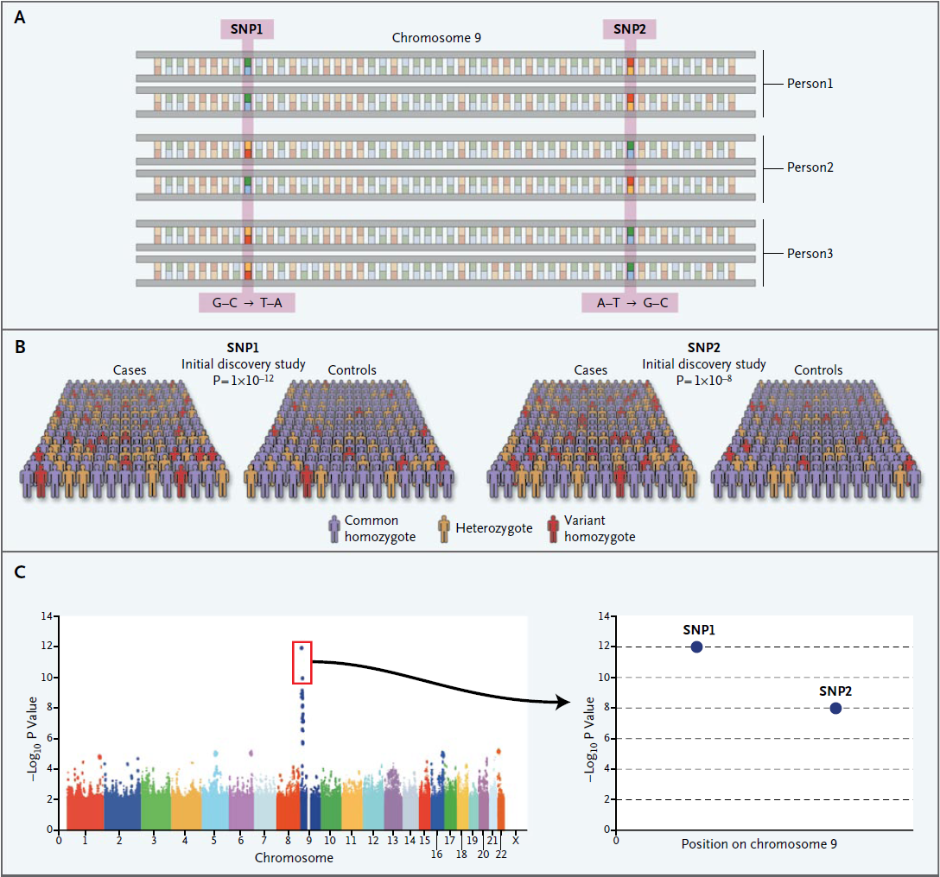
Replication is the key because “one study is no study”
First discover SNPs associated with the disease…
Manolio, TA, et al. NEJM; 363:2, 2010

Slide 35
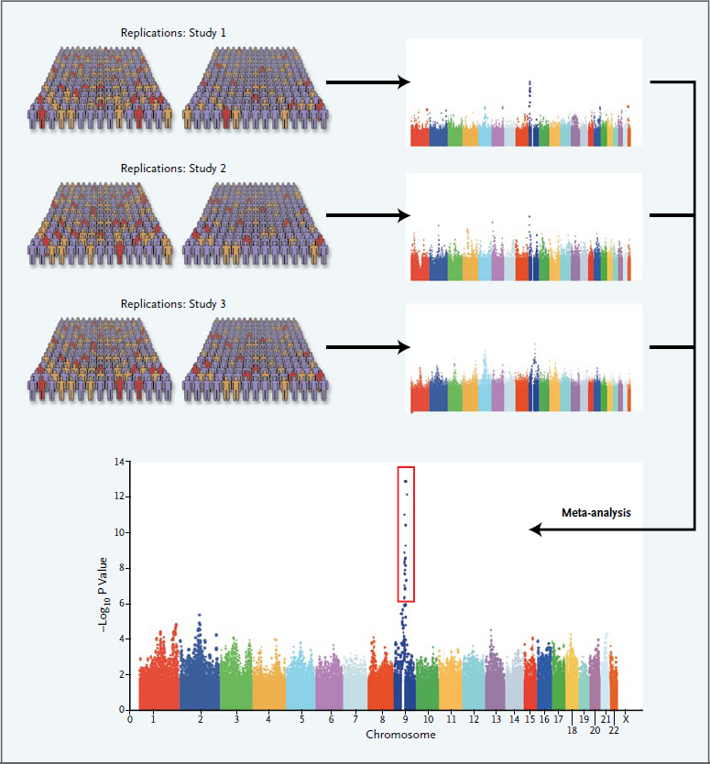
Replication is the key because “one study is no study”
Then try to replicate…
In many other populations
With the same phenotype
Meta-analysis
Manolio, TA, et al. NEJM; 363:2, 2010

Slide 36
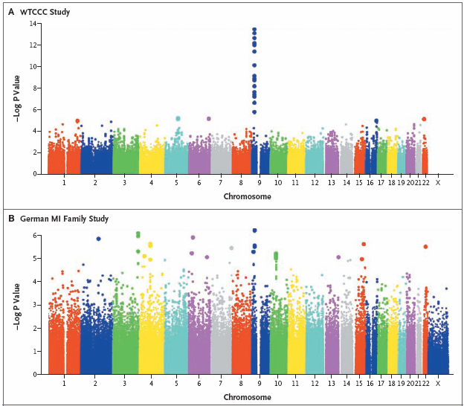
One famous example 9p21 in the Germans
In GWAS: “One study is no study”
Replication in German MI Family Study
875 MI cases
<60 years of age
≥1 family member affected (CAD)
1644 controls

Slide 37
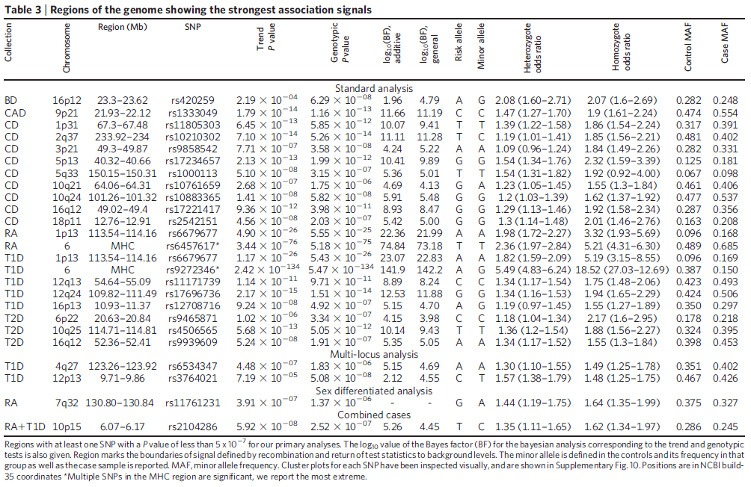
A closer look at the results
Wellcome Trust Case Control Consortium. Nature; 447(7145):661-678, 2007

Slide 38
Risk allele: minor allele
Odds ratio: the odds of exposure between cases and controls
CAD: coronary artery disease
9p21: chromosome 9, short arm (p)
Region: 21.93-22.12 megabase pairs
rs1333049: official dbSNP ID
P-value of association test: AA vs. AB vs. BB
Minor allele frequency: the frequency of the risk (minor) allele in the population

Slide 39
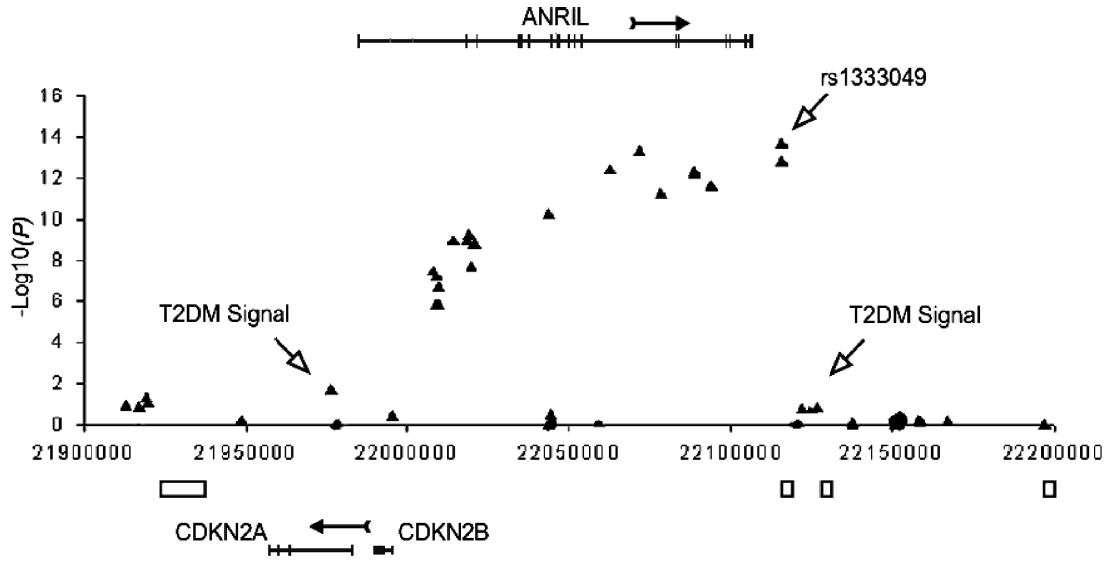
9p21 points to a RNA gene how does this explain an acute phenomenon like MI?
Resequencing unveiled a RNA gene, ANRIL
Current efforts are aimed to elucidate the role of ANRIL in (A)MI
Might be involved in early-onset MI (before age of 50 years)
Samani, NJ., et al. Circ Cardiovasc Genet; 1:81-84, 2008

Slide 40
9p21 is used in a laboratory DNA test
deCODE Genetics’ deCODE MI™
Assessment of the risk for (early–onset) myocardial infarction
SNPs rs133049 and rs10757278 located in vicinity to CDKN2A and CDKN2B
Risk allele is independent and additive to traditional risk factors (Framingham Heart Score, Reynold’s score, AIRIC score)
20-22% of the general population carry the risk allele
≥40% in patients suffering early MI (male < 50 years, female < 60 years)
Carrying two copies of the risk allele correspond to an approximate 1.6 fold increase over the general population of early onset MI and a 1.3 fold risk of MI in general
Tested according to CLIA, but not FDA approved
Collaboration with clinicians/clinical geneticists
Clear and concise report

Slide 41
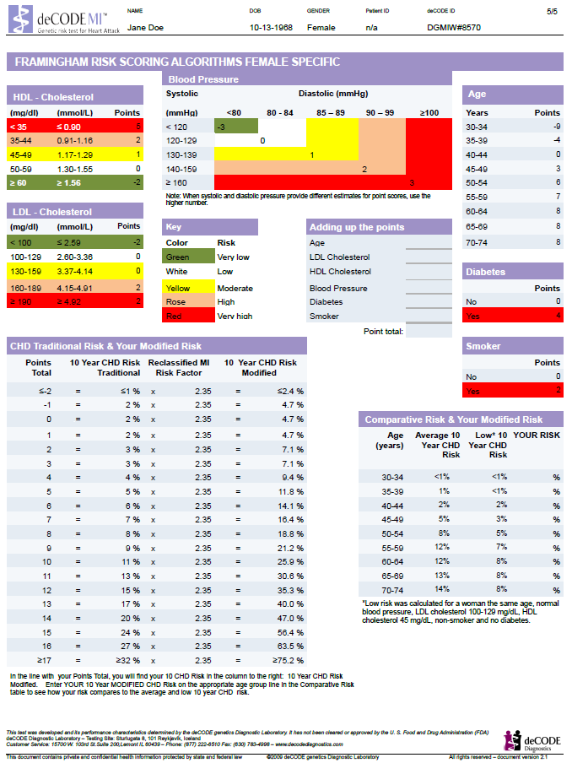
deCODE MI™ provides a modified 10 year CHD risk
Cut-off, at which point some form of (drug) therapy starts

Slide 42
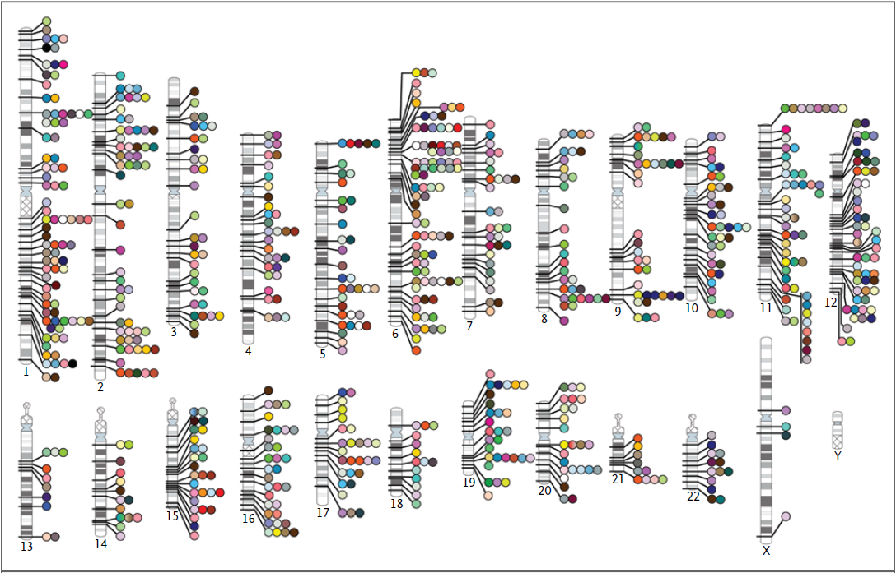
GWAS in March 2010 ≈545 studies, ≈ 800 SNPs & p≤5x10-8
Manolio, TA, et al. NEJM; 363:2, 2010

Slide 43



Interested in Cardiovascular Research?
Experimental Cardiology Laboratory
Prof. Dr. G. Pasterkamp
Prof. Dr. D.P.V. de Kleijn
Dr. J.P.G. Sluijter
Dr. I. Höfer
Dr. J.K. van Keulen
Dr. M. Smeets
Research topics
Biomarker Discovery & Validation
Athero-Express | CTMM: Circulating Cells | Toll Express
Regenerative Medicine in Ischaemic Heart Disease
Stem Cells | Progenitor Cells
Mechanisms of Arterial Occlusive Disease
Toll-like receptors | Regenerative Medicine | Arteriogenesis
Cardiovascular Genomics
www.umcutrecht.nl/experimentalcardiology

Slide 44
Further reading
Pearson, T.A. et al. How to interpret a GWAS - JAMA 2008 (PMID: 18349094)
Excellent to grasp the concepts of GWAS’
McCarthy, M.I. et al. GWAS for complex traits, consensus, uncertainty and challenges - Nature Rev Genet 2008 (PMID: 18398418)
Another excellent start to grasp the concepts of GWAS’
WTCCC - Genome-wide association study of 14,000 cases of seven common diseases and 3,000 shared controls - Nature 2007 (PMID: 17554300)
Pivotal article on a GWAS for CAD, only the CAD-section (including pictures/tables is interesting)
Robbins and Cotran – Pathologic Basis of Disease, 7th Edition
Page 149- 152: “Mendelian Disorders” on autosomal dominant, autosomal recessive and X-linked disorders
Page 154: “Marfan Syndrome”
page 156-158: “Familial Hypercholesterolemia”

